Slide 1

Optimal Route Planner
Domain: Travel and Logistics
By-
Mansi Jumde (B1-09)
Khushab likhitker (B1-07)
Radhika joshi (B3-35)

Slide 2
Problem Statement & Objective
Goal: To design an efficient system that computes the shortest travel routes between cities.
Problem:
Finding shortest paths between multiple cities is complex and repetitive.
Manual route calculation takes time and lacks optimization.
Objective:
Implement shortest path algorithm (Bellman-Ford / Floyd-Warshall).
Optimize with memoization for repeated queries.
Present results in a clear route-map view.

Slide 3
Algorithm & Approach
Algorithm Used: Bellman-Ford is a Dynamic Programming–based shortest path algorithm used to find the minimum distance from a source city to all other cities in a weighted road network (graph).
Steps-
Initialize all city distances as infinity.
Set source city distance to 0.
Relax all roads (edges) |V|−1 times. (Core step)
->Formula: if (dist.[u] + w < dist.[v]) then dist.[v] = dist.[u] + w
Check for negative weight cycles.(a route with inconsistent or unrealistic road data.)
The algorithm prints the shortest distances from the source city to every other city.
Dynamic Programming + Memoization:
Store results in a table to reuse for repeated source queries, improving efficiency.

Slide 4
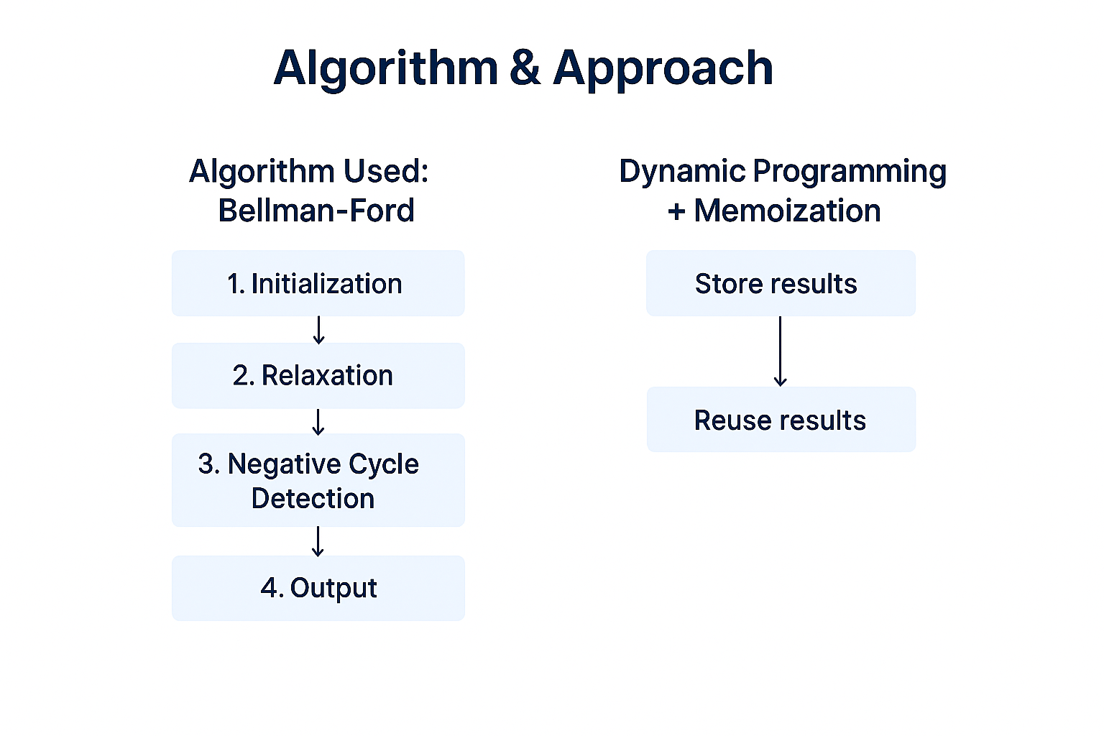
Dynamic Programming & Memoization:
Dynamic Programming:
Each Relaxation depends on previously computed shortest distances.
Hence, it’s a DP algorithm Memoization Enhancement:
When a source city’s routes are already computed, the results are stored in a 2D memo table: memo[src][dest] = shortest_distance;

Slide 5
Techniques used
Techniques | Description
Dynamic Programming | Algorithm builds shortest paths step-by-step using relaxation.
Memoization | Stores computed results to avoid recomputation.
File Handling (CSV) | Saves results for later visualization
Networkx Library | Creates and analysis directed weighted graphs
Matplotlib Library | Visualization nodes, edges and routes.
Pandas | Reads and writes CSV files efficiently

Slide 6
Implementation Overview
Input stage
User interaction
Processing stage
Distance Array
Output Stage
Graph

Slide 7
Benefits & Results
Benefits:
Ensures correctness even in graphs with negative edge weights.
Significantly reduces computation time for repeated queries.
Makes the program faster and more efficient — a crucial factor for large networks.
Application remains interactive and realistic for testing different city networks.
Results:
Successfully computes optimal routes between all entered cities.
Detects negative cycles automatically.
Faster performance for repeated city queries.

Slide 8
Conclusion & future scopes
Conclusion:
Bellman-Ford Algorithm effectively finds the shortest paths between cities.
Memoization used paths are stored, avoiding unnecessary recalculations.
User inputs, data structures, and validation.
Dynamic Programming theory can be applied in real-world domains like
travel, logistics, and route optimization.
Future Scopes:
GUI Map Visualization
GPS Integration
Real-Time Traffic Analysis
Multi-Modal Transport Planning

